Slide 1
IRRI-Myanmar partnership: current and future perspectives for rice breeding
RK Singh
Rice Breeder
IRRI, Philippines

Slide 2
Partnership in Breeding
Since the start of collaboration in 1965 – IRRI has contributed a lot for the germplasm development.
Max number of rice varieties released in Myanmar has lineage of IRRI
Since 2013 onward, about 14 varieties released – IRRI role
Further Scope:
Though Myanmar is not a rice deficient country but rice yield stability in different regions is needed for proper rice distribution. – Appropriate rice varieties

Slide 3
Rice product profile for deltas of SE Asia (Target Region)
Target Deltaic regions Season - WS | Ayyerwaddy - Myanmar
Must Traits Grain yield 2. Grain Quality 3a. Stress tolerance (Abiotic) 3b. Stress tolerance (Biotic) | High (>10% Sin Thu Kha or Sin Thew Latt) Inter. AC , GT- Inter; GC >60mm); Chalk <10%; LS-MS Flooding tolerance (Sub1) Stagnant flooding tolerance Salinity tolerance – Reproductive stage Bacterial Blight
Range Traits Duration (days) 2. Plant height (cm) 3. HRR | 135-140 days (Also good to have weak photosensitive varieties) 100-125 >45%
Value Addition (Win traits) | 1. AG tolerance 2. Aromatic grains

Slide 4
Rice product profile for deltas of SE Asia (Target Region)
Target Deltaic regions Season - DS | Ayyerwaddy - Myanmar
Must Traits Grain yield 2. Grain Quality 3a. Stress tolerance (Abiotic) 3b. Stress tolerance (Biotic) | High > 5 t/ha Inter. AC , GT- Inter; GC >60mm); Chalk <10%; LS-MS Stagnant flooding tolerance Salinity tolerance throughout Bacterial Blight and Blast
Range Traits Duration (days) 2. Plant height (cm) 3. HRR | 120-125 days 100-110 >45%
Value Addition (Win traits) | 1. AG tolerance 2. Aromatic grains

Slide 5
Paw San – Big potential
To compete with international market- unique material
Paw San – pearl rice (best in 2010) – is the variety which is widely acclaimed as best bet from Myanmar as exportable rice on premium price
Just one event of international rice traders – famous - Branding
Also has big domestic market
Poor plant type, Photosensitive and non-responsive to inputs - IRRI- KIT, Germany - Japan with YAU/DAR
Could be improved for plant type and photosensitivity keeping the grain quality intact + abiotic and biotic stresses tolerance

Slide 6
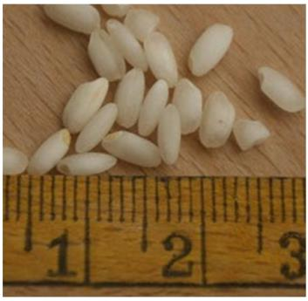
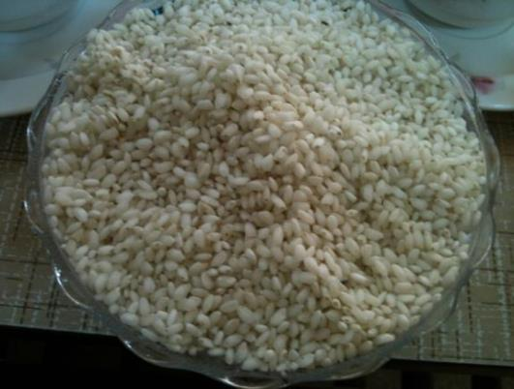
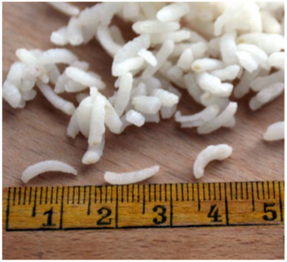
Paw San – Pearl rice
Raw rice
Cooked rice (>2.5 – 3 times expansion)
Strongly aromatic

Slide 7
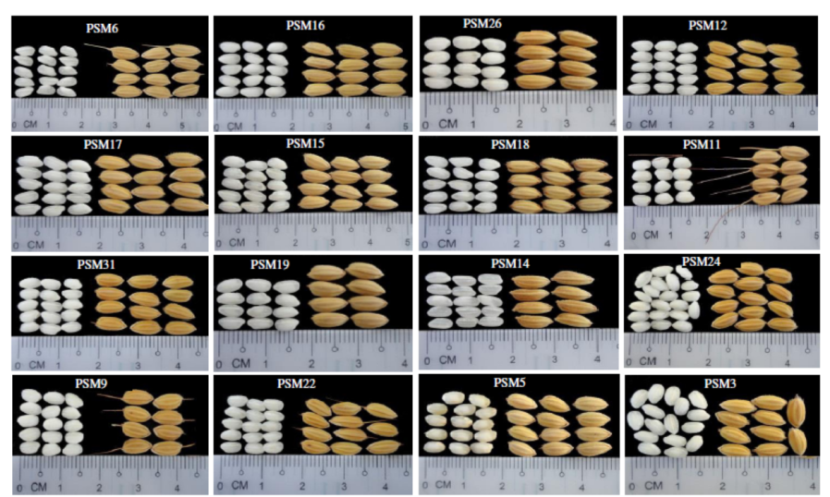
Paw San Diversity

Slide 8
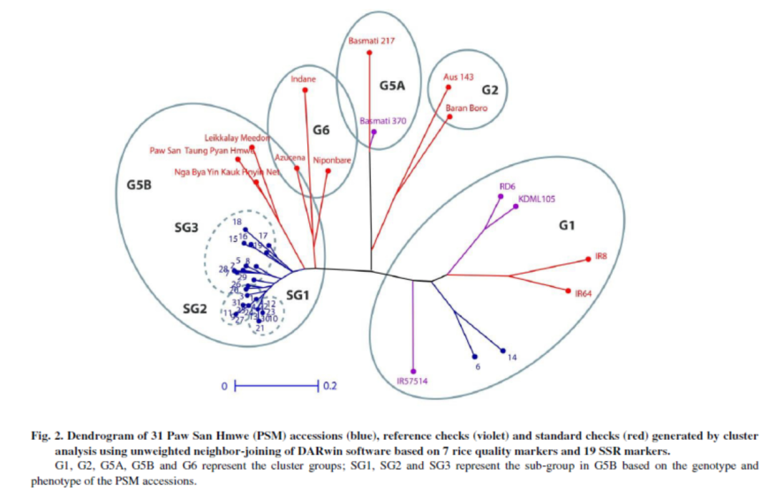
Clustering of the aromatic rices
Source: So et al. 2015. Rice Science 22: 53-64

Slide 9
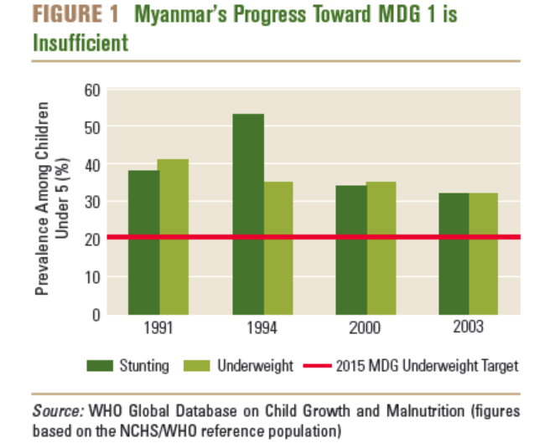
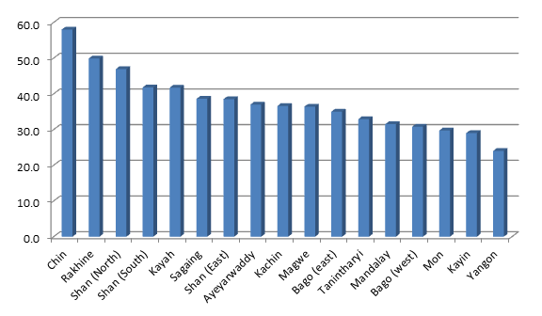
Healthy rice
Micronutrient deficiencies in Myanmar
Micro- nutrient | % | Population group & status indicator
Iron | 63.2 | Preschool-age children with anemia (hemoglobin < 110 g/L)
 | 49.6 | Pregnant women with anemia (hemoglobin < 110 g/L)
 | 44.9 | Non-pregnant women with anemia (hemoglobin < 120 g/L)
Vitamin A | 36.7 | Preschool-age children vit. A deficiency (serum retinol < 0.70 μmol/L)
 | 1.1 | Pregnant women with night blindness
Zinc | 34.6 | Population at risk of inadequate intake of zinc
SOURCE: Investing in the future - A united call to action on vitamin and mineral deficiencies. UNICEF, GAIN, MI, USAID, World Bank, FFI; 2009.
http://www.unitedcalltoaction.org/documents/Investing_in_the_future.pdf
- WHO, CDC. Worldwide prevalence of anemia 1995-2005. WHO Global database on anemia. Geneva, World Health Organisation, 2008.
- WHO. Global prevalence of vitamin A deficiency in populations at risk 1995-2005. WHO Global database on vitamin A deficiency. Geneva, World Health Organisation, 2009.
- WHO Global database on iodine deficiency: http://www.who.int/vmnis/iodine/data/en/index.html, accessed 31 July 2007.
- IZiNCG Estimated Risk of Zinc Deficiency, Food and Nutrition Bulletin, vol. 25, no. 1 suppl 2 (2004).
LEGEND
* Countries with a GDP > US$ 15’000 are assumed to be free of vitamin A deficiency of public health significance.
N/A or "-": Data not available.
Stunting by state/region
Source : M. Swamy
Source: http://www.worldlifeexpectancy.com/cause-of-death/malnutrition/by-country/

Slide 10
Healthy rice
Besides two breeding pipelines, IRRI nutritional quality rice group has finalised the plan to initiate the activities in Myanmar and evaluate the materials from 2016 WS.
Healthier is need of the hour in Myanmar (high Fe, high Zn and low GI) but non-transgenic
IRRI can immensely contribute to this noble cause

Slide 11
Climate Change Scenario
Expected scenarios: Sea level rice, more frequent drought and flooding spells, high day and night time temperature, change in biotic stress pattern. Coastal and dry zones would be more vulnerable
IRRI is in better position to develop the suitable climate smart varieties with mitigation techniques (management) Example: Recent release of new stress tolerant varieties

Slide 12
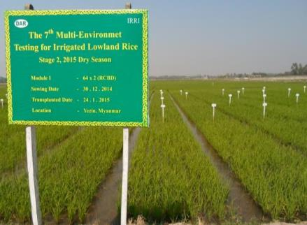
Favourable areas for production boost
Irrigated : Need more resources – IRRI can partially help with agronomically superior genotypes (inbreds and hybrids – through HRDC)
DAR Yezin has now become a key location for evaluating yield performance in Myanmar
Seed replacement rate
– very low even in irrigated

Slide 13
Plant Varieties Development
Seed Multiplication Chain
Different breeding methods
OYT
Yield Trials (at least 3 times)
Farmers field testing
Promising entries to Technical sub-committee
National seed committee (NSC)
Nomination new varieties and release
Seed multiplication and distribution
Breeder Seed - DAR
FS – DAR /DOA-Seed division
RS – Seed farms managed by DAR / DOA
CS – seed village schemes, contract farmers, NGO, private seed company
Government township office,
agro-dealers, NGO , millers
Farmers
> 5 years
> 10 years

Slide 14
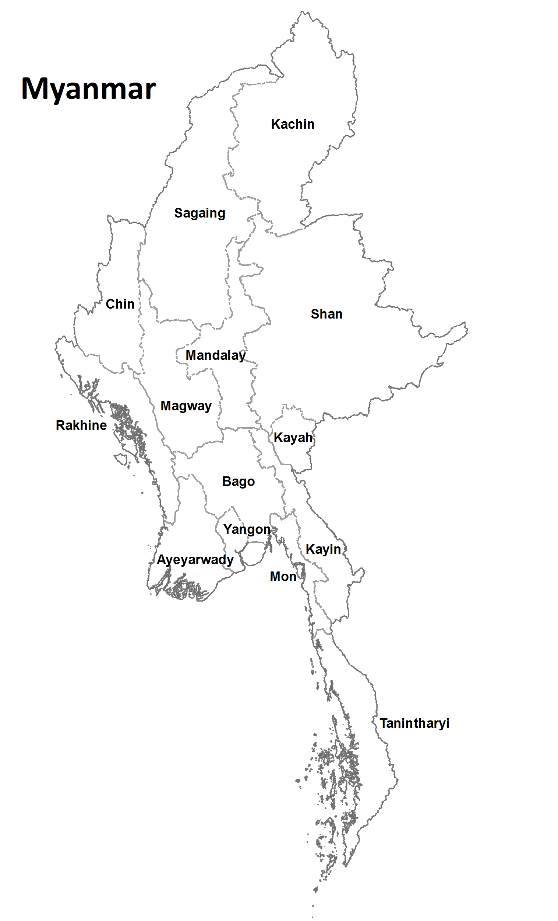
Myanmar next IRRI-Hub
If the HUB country is long – latitude wise, we get many different environments – Myanmar provides large range of environments. (high variation in rainfall also – about 1000 – 5000 mm)
28°31’ N
Dry Zone – drought and cold
Wet Zone – High productivity
1009 km
Delta zone – Flooding, Salinity, two crops
9°32’ N

Slide 15
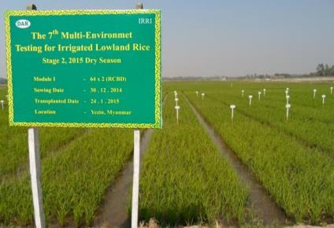
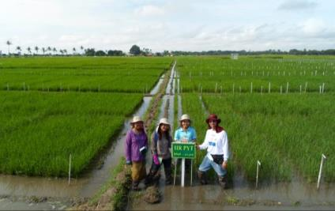
IRRI- Multi-environment trials
Yezin has now become a key location for extended rice breeding facility in Myanmar

Slide 16
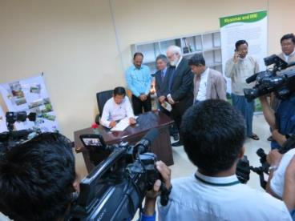
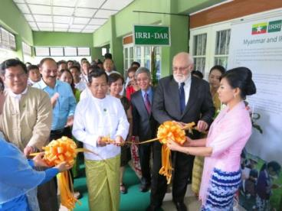
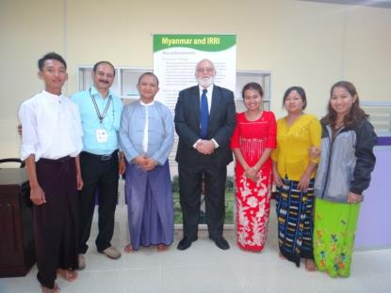
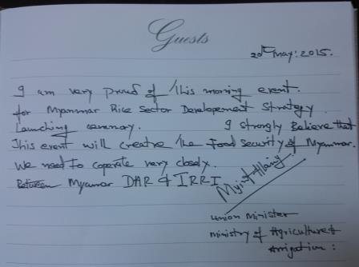
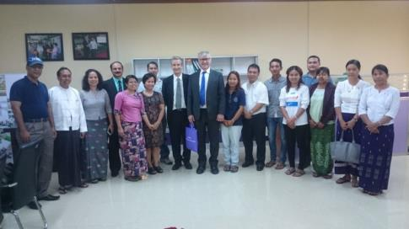
IRRI –Hub Inaugurated

Slide 17
Thanks

